Slide 1
File handling in C
Searching and sorting

Slide 2

File
Storage of data in variables and arrays is temporary such data is lost when a program terminates.
Files are used for permanent retention of data.
Computers store files on secondary storage devices, such as hard drives, CDs, DVDs and flash drives.

Slide 3
Text files vs Binary files
Text file is a term used for a file that is essentially a sequence of character codes.
Binary file is a term used for a file in which most byte are not intended to be interpreted as character codes.
Here are a few common binary file formats:
PDF, for documents
JPEG, GIF, and PNG, for images
MP3, for audio tracks

Slide 4
Steps to create and open a file
Create file by a pointer variable using the FILE structure:
FILE *p;
Open the file, associating the file name.
Read or write the data.
Close the file.

Slide 5
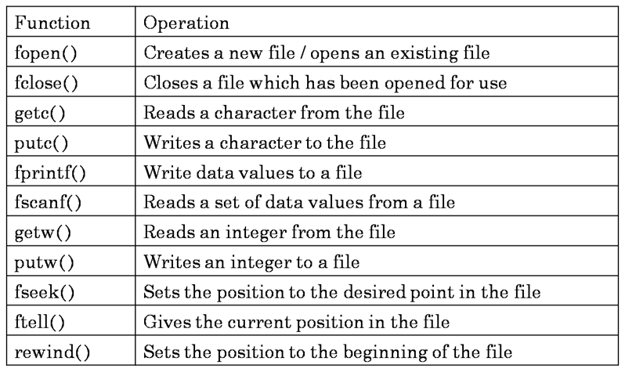
File operations

Slide 6
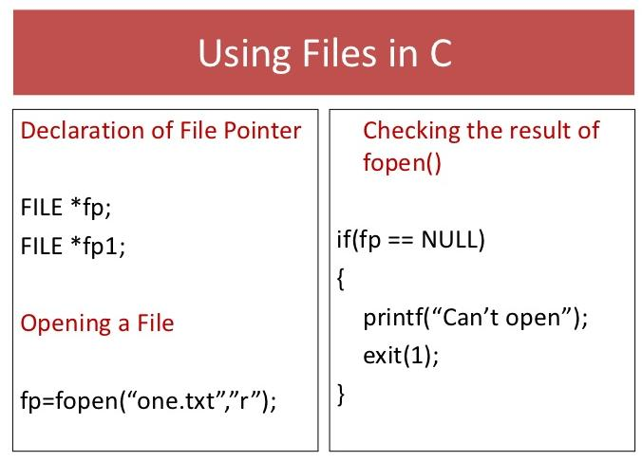
Open the file using : fopen()
FILE *fopen(const char *filename, const char *mode);

Slide 7
File opening modes
“r” Opens a text file in reading mode
“w” Opens or create a text file in writing mode
“a” Opens a text file in append mode
“r+” Opens a text file in both reading and writing mode
“w+” Opens a text file in both reading and writing mode
“a+” Opens a binary file in reading mode
“rb” Opens a binary file in reading mode
“wb” Opens or create a binary file in writing mode

Slide 8
Functions to read and write data to file
Function fprintf
Like printf
Takes first argument as file pointer
Function fscanf
Like scanf
Takes first argument as file pointer

Slide 9
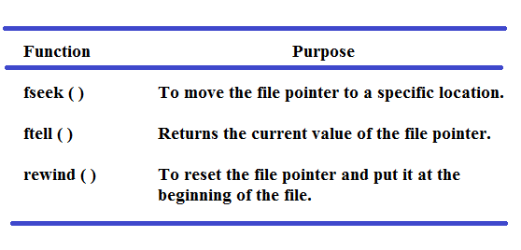
Random Access of Files

Slide 10
fseek()
It sets the file pointer associated with file handle to a new position
This function is used to move the file pointer to different positions
fseek(fptr,offset,mode);
Where
fptr is a file pointer
offset is an integer that specifies the number of bytes by which file pointer is moved
mode specifies from which position the offset is measured
Its value is 0,1,2
0 represents beginning of the file(SEEK_SET)
1 represents current position (SEEK_CUR)
2 represents end of file (SEEK_END)

Slide 11
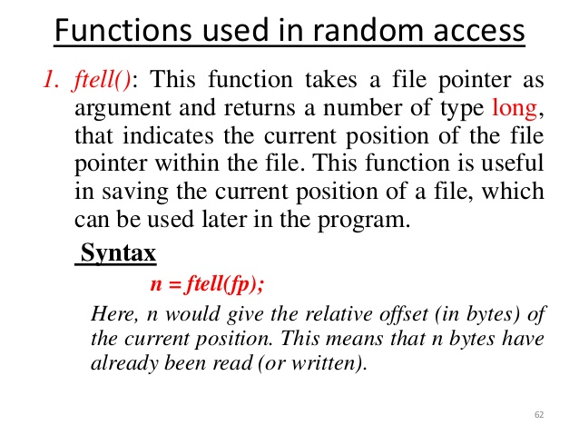

Slide 12
Searching
Searching and sorting are the two essential aspects of computer science.
In Searching we search for a particular key or a file
Two types of searching
Linear search
Binary search

Slide 13
Linear search
Linear search is also known as sequential search, where we search an key against an array in a linear.
Algorithm for searching
linear_search(a[0…..n],n,key)
{
for(i=0 to n)
if(a[i] = key)
search is successful
}

Slide 14
Binary search
One of the most efficient search algorithm.
Here we divide the array in to two half and search for a particular key
Array should be always sorted
Each time an array with n elements is divided into
n/2,n/4,n/8……...n/2^{k} times

Slide 15
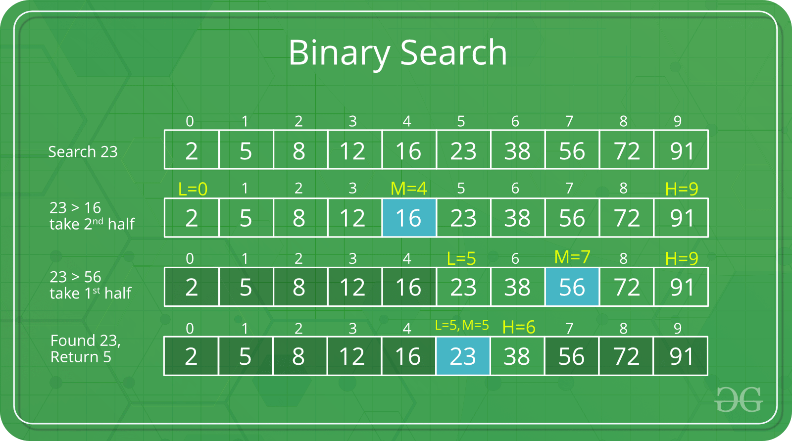
Source geeksforgeeks

Slide 16
Binary search algorithm
binary_search(A,n,key)
{
b=0,e=n-1
while(b<e)
{
Mid = (b+e)/2
if(a[mid]==key)
Search found
elseif(key>a[mid])
b=mid+1
else
e=mid-1
}
}

Slide 17
SORTING
Arranging elements in order is called sorting
Sorting helps to search an element more effectively
There are many techniques in sorting
Bubble sort
Selection sort
Insertion sort
Merge sort
Quick sort
Radix sort

Slide 18
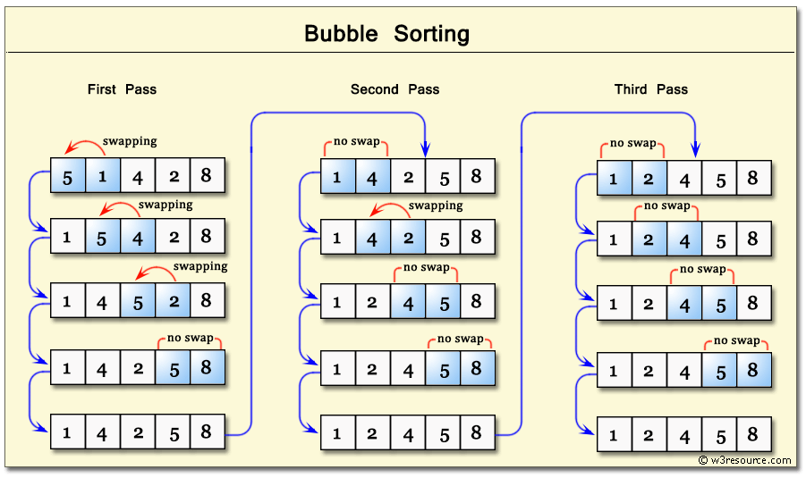
Bubble sort
This is a brute force techniques , where we compare each element with
next element and arrange in order

Slide 19
BUBBLE SORT Algorithm
bubble_sort(a[0...n],n)//n is the size of the array
{
for(i=0 to n)
{
for(j=0 to n-i-1)
{
if(a[j] > a[j+1])
swap(a[j] with a[j+1])
}
}
}

Slide 20
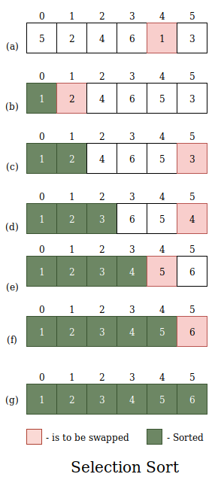
SELECTION SORT
As the name says select the element and swap with starting element.

Slide 21
SELECTION SORT ALGORITHM
selection_sort(a[0....n], n)
{
for(i=0 to n)
{
for(j=0 to n)
{
if(min(a[j]))
}
swap(min with a[i])
}
}

